Slide 1
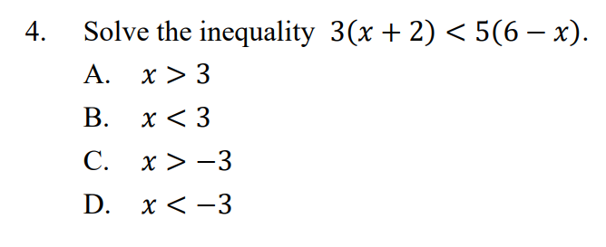





3x
$$+$$
5x
$$−$$
6
30
$$+$$
6
$$−$$
5x
3x
30
8x
24
x
3

Slide 2
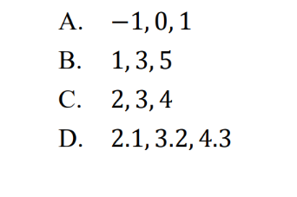




7x
$$−$$
3
17
7x
14
x
2
$$∵$$
The numbers in the group must be larger than 2.
$$∵$$
Only 2.1, 3.2, 4.3 can satisfy the requirement.

Slide 3












x
x
(a)
$$+$$
$$0.8$$
$$+$$
$$2$$
$$4$$
$$3$$
3x
$$+$$
4x
$$2.8$$
$$12$$
7x
$$2.8$$
$$12$$
x
$$4.8$$
(b)
The required positive integers are 4,3,2 and 1.

